Slide 1
Time Series Modelling FMCG-Sales1
Presented by Group-2
Dinesh P - D18029
Parthipan V - D18025
Praveen P – D18027
Gontla Praveen – D18009
Rohan Isaac – D18033
Shubham Bansla – D18037

Slide 2
Contents
Introduction
Exploratory Data Analysis
Component of Time Series
Simple Moving Average
Naïve’s Prediction
Holt Winter Prediction
Auto ARIMA Prediction
Model Selection
Conclusion
Appendix

Slide 3
Introduction
Performed Time series forecasting on the data to predict the sales of shampoo on monthly basis during the three periods of time that is from 1995 to 1997. Our data consist of 36 observation and two columns one is month and year and other one is no of sales in a given month.
We performed three techniques to predict first one is Naïve’s, Holt Winter and Auto ARIMA and compared which model is best for prediction using model metrics.

Slide 4
Exploratory Analysis For Time Series

Slide 5
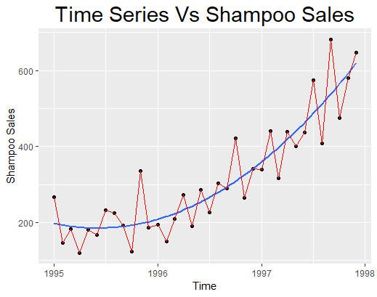
Time Series Plot
From this plot we are able to see that the curve follows an additive model since the variation is almost constant in this time series.
Hence our model should follow this,
Y = S + T + R
Where,
S = seasonal component
T = Trend component
R = Random component

Slide 6
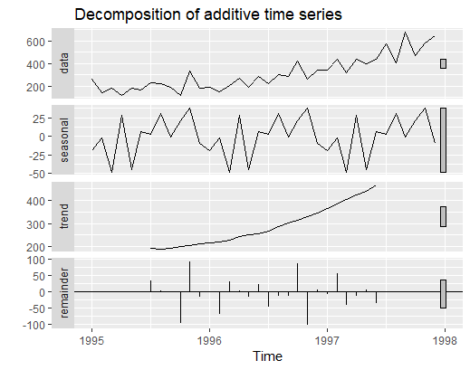
Components of Time Series Model
To identify the components in the series if they are present we usually perform a decomposition of the model.
From the decomposition,
We are able to see a repeated pattern in seasonality signifying the series to have a strong seasonal pattern.
A positive trend is observed along the plot of the series.
We see the pattern to consist noise showing that there is a random component occurring in the series.

Slide 7
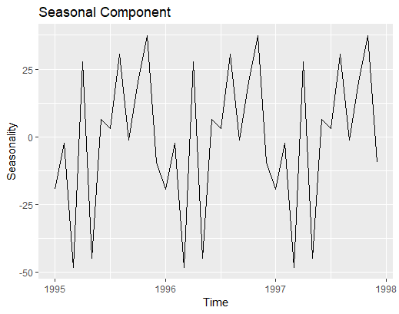
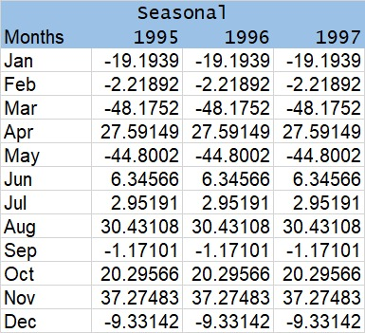
Seasonal Component

Slide 8
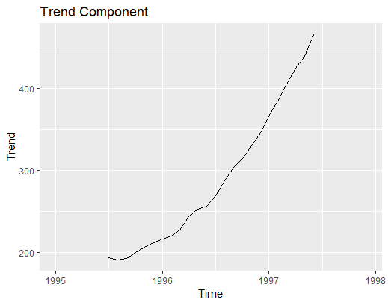
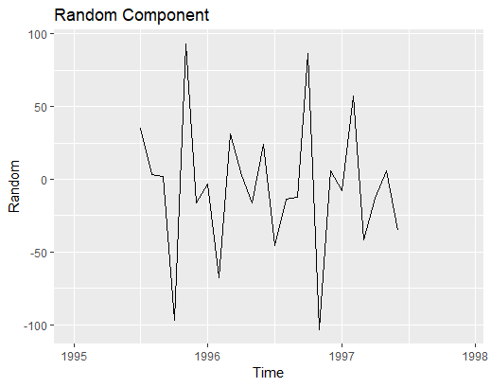
Trend and Random Component

Slide 9
Simple Moving Average

Slide 10
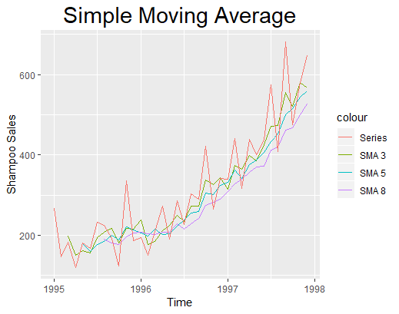
The simple moving average smooths out volatility and makes it easier to view the trend of our data.
Short term averages here respond quickly to change and long term averages are slow to respond to changes.
Here we see the same pattern to exist and larger SMA’s clearly show a positive trend in the data.

Slide 11
Naïve’s Prediction

Slide 12
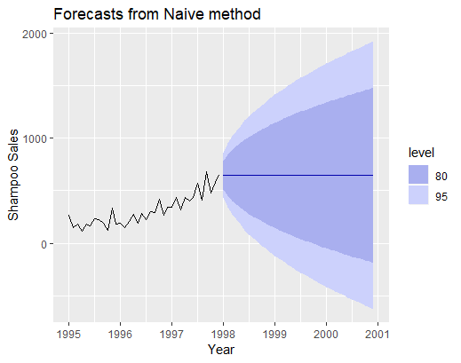
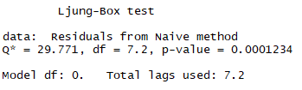
Estimating technique in which the last period's actuals are used as this period's forecast, without adjusting them or attempting to establish causal factors.
It is used only for comparison with the forecasts generated by the better (sophisticated) techniques.

Slide 13
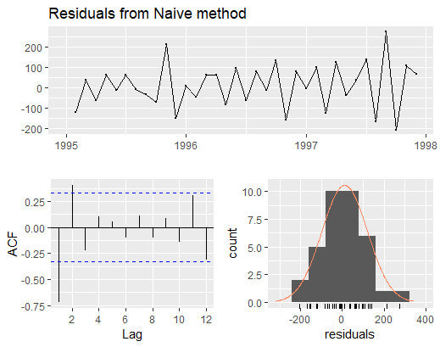

Slide 14
Holt Winter Prediction

Slide 15
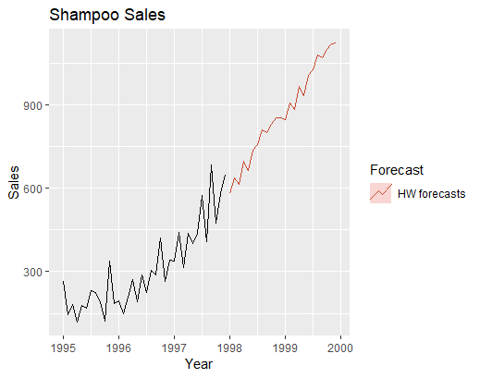



Holt Winter Prediction uses mainly three parameters,
Error
Trend
Seasonality
Holt Winter prediction is basically a smoothening technique prediction method and hence is simpler.
Here we are able to see the forecast is a bit aggressive and since not much parameters are included the predictions might be off. Still we should consider it since it outperform other models.

Slide 16
Auto ARIMA

Slide 17
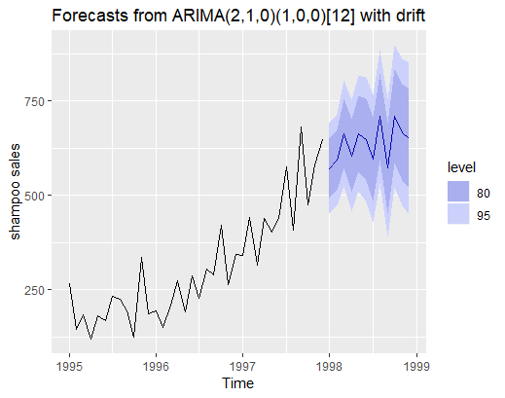
Auto ARIMA chooses the best parameters and creates the ARIMA model.
It selects the optimal differencing, p and q values and forecasts for our data.
Here we are able to see ARIMA is able to predict well. Since it uses more parameters for forecasting it is able to mostly do a better prediction.

Slide 18
Model Comparison

Slide 19
Model Metrics
 | Naïve’s Model | Holt Winter Model | Auto ARIMA Model
RMSE | 108.2376 | 71.33693 | 57.20783
MAE | 88.22 | 55.9554 | 43.7943
MAPE | 30.41291 | 21.2602 | 18.43179
MASE | 0.5747075 | 0.3645209 | 0.2852972

Slide 20
Conclusion
Here we have compared the naïve, holt winter and auto ARIMA models.
We see auto ARIMA is best model in our case since the error metrics are less as compared to other models.
Since auto ARIMA uses significantly higher number of parameters we are able to see it is able to give less errors.

Slide 21
End of slide

